Slide 1
Managing Linux Processes
Chapter 9

Slide 2
Objectives
After completing this chapter, you will be able to:
Categorize the different types of processes on a Linux system
View processes using standard Linux utilities
Explain the difference between common kill signals
Describe how binary programs and shell scripts are executed
Create and manipulate background processes
Use standard Linux utilities to modify the priority of a process
Schedule commands to execute in the future using the at daemon
Schedule commands to execute repetitively using the cron daemon

Slide 3
Linux Processes (1 of 5)
Program: executable file
Can be run when executed
Process: program running in memory and on CPU
A program in action
User process: process run on a terminal
Daemon process: system process
Not associated with a terminal

Slide 4
Linux Processes (2 of 5)
Process ID (PID): unique identifier assigned to a process
Child process: process started by another process (parent process)
Parent process: process that has started other processes (child processes)
Parent Process ID (PPID): identifies the process that started it

Slide 5
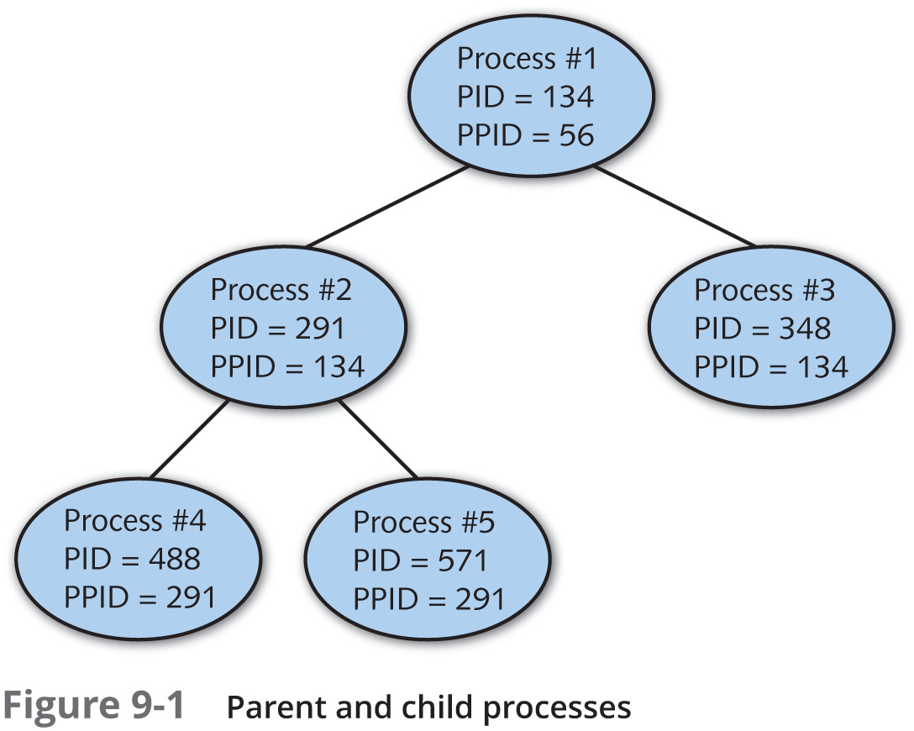
Linux Processes (3 of 5)
Figure 9-1: Parent and child processes

Slide 6
Linux Processes (4 of 5)
The init daemon starts most other daemons during the system initialization process
Including those that allow for user logins
The login program starts a BASH shell
BASH shell then interprets user commands and starts all user processes
Each process on the Linux system can be traced back to the init daemon by examining PPIDs

Slide 7
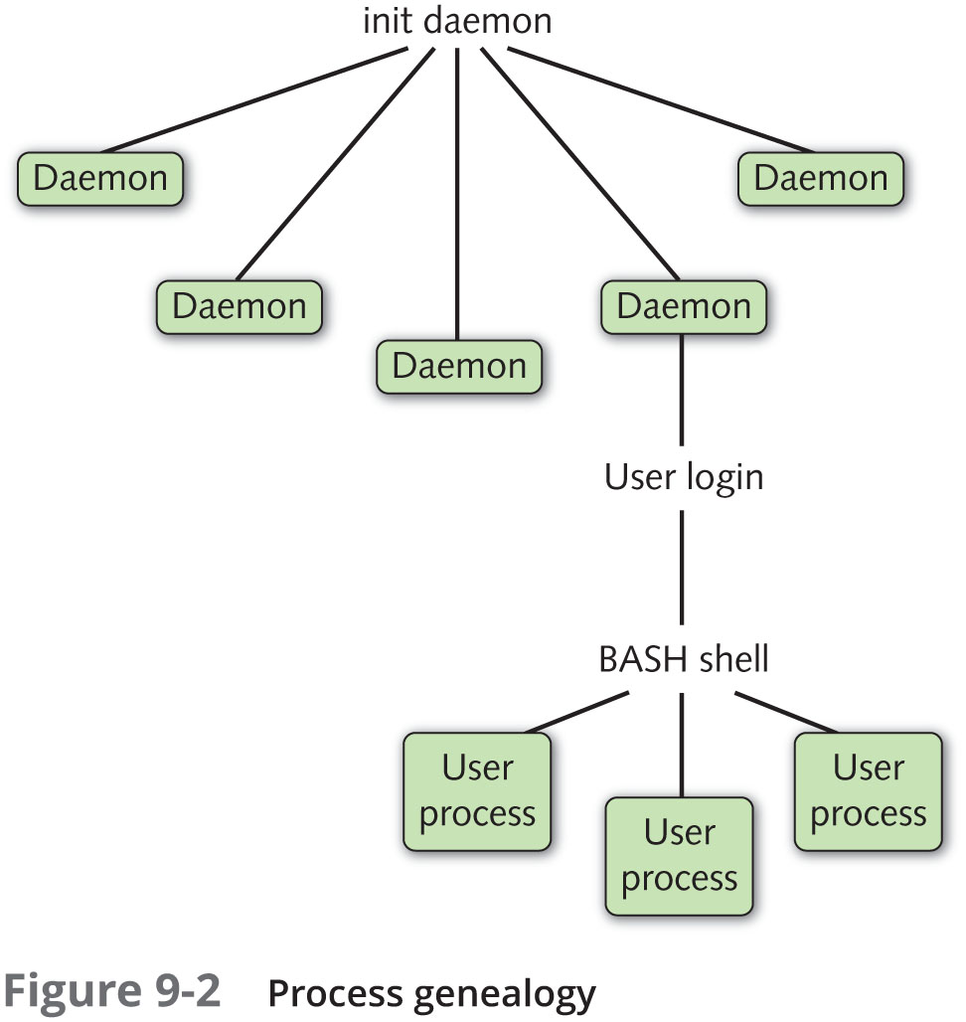
Linux Processes (5 of 5)
Figure 9-2: Process genealogy

Slide 8
Viewing Processes (1 of 5)
The ps command: used to view processes
Most versatile and common process viewing utility
The –f (full) option: more complete information
User identifier (UID), PPID, start time, CPU utilization
The -e option: displays the entire list of processes across all terminals including daemons

Slide 9
Viewing Processes (2 of 5)
Process flag: indicates particular features of the process
Process state: current processor state of process
Sleeping (S) or running (R)
Zombie process: process is finished, but parent has not released child process’s PID
Defunct process
Process state is Z

Slide 10
Viewing Processes (3 of 5)
Process priority (PRI): priority used by the kernel for the process
Measured between 0 (high priority) and 127 (low priority)
Nice value (NI): can be used to affect the process priority indirectly
Measured between -20 (a greater chance of a high priority) and 19 (a greater chance of a lower priority)
The size of the process in memory (SZ) is listed and measured in kilobytes

Slide 11
Viewing Processes (4 of 5)
Some options to the ps command are not prefixed by a dash (-) character
Referred to as Berkeley style options
Two most common of these are:
The a option: lists all processes across terminals
The x option: lists processes that do not run on a terminal
The pstree command: displays the lineage of a process by tracing its PPIDs until the init daemon

Slide 12
Viewing Processes (5 of 5)
The top command: displays an interactive screen listing processes
Organized by processor time
Processes using most processor time are listed first
Rogue process: faulty process
Consumes excessive system resources
The top command can be used to change the priority of processes or to kill processes
Rogue processes can be killed immediately when identified

Slide 13
Killing Processes (1 of 4)
The kill command: sends a kill signal to a process to terminate it
64 types of kill signals
Each affects processes in different ways
-l option: displays a list of kill signal names and associated numbers

Slide 14
Killing Processes (2 of 4)
Table 9-2: Common administrative kill signals
Name | Number | Description
SIGHUP | 1 | Also known as the hang-up signal, it stops a process, then restarts it with the same PID. If you edit the configuration file used by a running daemon, that daemon might be sent a SIGHUP to restart the process; when the daemon starts again, it reads the new configuration file.
SIGINT | 2 | This signal sends an interrupt signal to a process. Although this signal is one of the weakest kill signals, it works most of the time. When you use the Ctrl+c key combination to kill a currently running process, a SIGINT is actually being sent to the process.
SIGQUIT | 3 | Also known as a core dump, the quit signal terminates a process by taking the process information in memory and saving it to a file called core on the hard disk in the current working directory. You can use the Ctrl+\ key combination to send a SIGQUIT to a process that is currently running.
SIGTERM | 15 | The software termination signal is the most common kill signal used by programs to kill other processes. It is the default kill signal used by the kill command.
SIGKILL | 9 | Also known as the absolute kill signal, it forces the Linux kernel to stop executing the process by sending the process’s resources to a special device file called /dev/null.

Slide 15
Killing Processes (3 of 4)
Trap: the ability to ignore a kill signal
The SIGKILL signal cannot be trapped by any process
Use only as last resort because it prevents a process from closing temporary files and resources properly
When a parent process receives a kill signal, the parent process terminates all child processes before terminating itself
To kill several related processes send signal to parent process
Kill parent process in order to kill zombie processes

Slide 16
Killing Processes (4 of 4)
The killall command: kills multiple processes of the same name in one command
Takes kill signal number as an option
Uses process name instead of PID
The pkill command: kill processes by process name
Allows you to identify process names using regular expressions as well as specify other criteria

Slide 17
Process Execution (1 of 3)
Three main types of executable commands
Binary programs
Shell scripts
Shell functions

Slide 18
Process Execution (2 of 3)
Forking: act of creating new BASH shell or subshell
Carried out by the fork function in the BASH shell
Subshell executes program or shell script using exec function
Original BASH shell uses its wait function to wait for the new BASH shell to carry out the aforementioned tasks before returning a prompt to the user

Slide 19
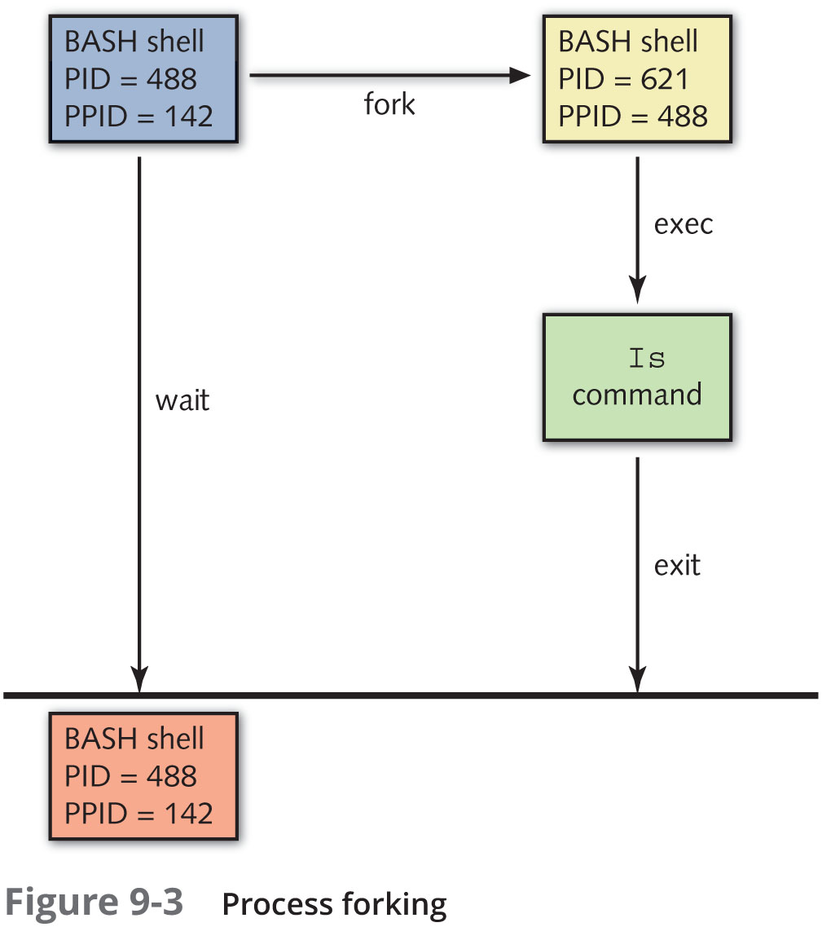
Process Execution (3 of 3)
Figure 9-3: Process forking

Slide 20
Running Processes in the Background (1 of 3)
Foreground processes: BASH shell must wait for the command in the subshell to finish before displaying a shell prompt to accept new commands
Background processes: BASH shell does not wait
Omit the wait function by appending an ampersand (&) character to the command
When a command is run in the background, the shell immediately returns the shell prompt for the user to enter another command

Slide 21
Running Processes in the Background (2 of 3)
The jobs command: lists background job IDs for processes running in current shell
To terminate a background process:
Send a kill signal to the PID
You can also send a kill signal to background job ID
Prefix job ID with a percent (%) character

Slide 22
Running Processes in the Background (3 of 3)
The foreground (fg) command: moves a background process to the foreground
Use Ctrl+z to pause a foreground process
Assigns the process a background job ID
The background (bg) command: send an existing process to the background
Provide background job ID as argument
The jobs command indicates the two most recent background processes
By default, commands apply to most recent process

Slide 23
Process Priorities (1 of 2)
Time slice: amount of time a process is given on a CPU
More time slices mean more execution time on CPU
Executes faster
Usually measured in milliseconds

Slide 24
Process Priorities (2 of 2)
PRI dictates number of time slices a process gets
Cannot change PRI value directly
Set the nice value (NI) to indirectly affect priority
A negative NI value, more time slices; a positive NI value, less time slices
Processes start with NI of 0 by default
The nice command: change a process’s priority as it starts
The renice command: alter process priority after it has been started
Root user can use the renice command to change the priority of all processes that are owned by a certain user or group

Slide 25
Scheduling Commands
Scheduling system maintenance commands to run during nonworking hours is good practice
To schedule commands to execute in the future:
The at daemon (atd): system daemon that executes tasks at a future time
The cron daemon (crond): system daemon that executes tasks repetitively in the future

Slide 26
Scheduling Commands with atd (1 of 3)
The at command: schedule a command or set of commands for execution at a later time by the at daemon
After being invoked, the at command displays an at> prompt
Allows you to type commands to be executed
One per line
After commands have been entered
Use the Ctrl+d key combination to schedule the commands

Slide 27
Scheduling Commands with atd (2 of 3)
Common options available with the at command
–l option: view a list of at job IDs
–c option: view content of a specified at job
–d option: delete the specified at job
–f option: list commands to be scheduled by at from a shell script

Slide 28
Scheduling Commands with atd (3 of 3)
If the /etc/at.allow and /etc/at.deny files do not exist
Only the root user is allowed to schedule tasks using the at daemon
To give this ability to other users
Create an /etc/at.allow file and add the names of users allowed to use the at daemon, one per line
Use the /etc/at.deny file to deny certain users access to the at daemon
If both files exist, the system checks the /etc/at.allow file and does not process the /etc/at.deny file

Slide 29
Scheduling Commands with cron
Suitable for scheduling repetitive tasks
Uses configuration files called cron tables to specify when a command should be executed
Cron tables
Six fields separated by space or tab characters
First five specify times to run the command
Sixth absolute pathname to command to be executed
Two types of cron tables are used by the cron daemon
User cron tables: represent tasks scheduled by individual users
System cron tables: contains system tasks

Slide 30
User Cron Tables (1 of 2)
/etc/cron.allow: a file that lists users allowed to use the cron daemon
/etc/cron.deny: a file that lists users not allowed to use the cron daemon
If both files exist, only the /etc/cron.allow file is processed
If neither file exists, all users are allowed to schedule tasks

Slide 31
User Cron Tables (2 of 2)
The crontab command: use to create or edit user cron tables
–e option: edit cron tables in vi editor
–l option: list a user cron table
–r option: remove cron table and all scheduled jobs
-u option: used by root user to edit, list, or remove a specified user’s cron table

Slide 32
System Cron Table (1 of 3)
System maintenance, backups, and CPU-intensive tasks are often scheduled for non-business hours
Most of these tasks are scheduled by the cron daemon
From entries in system cron table (/etc/crontab)
These entries can only be edited by the root user

Slide 33
System Cron Table (2 of 3)
Initial section of cron table specifies execution environment
Remainder of the file contains comments that identify the format of a cron table entry
You may prefix the command within a system cron table entry with the user account that it should be executed as
Cron tables located in the /etc/cron.d directory

Slide 34
System Cron Table (3 of 3)
Many administrative tasks are performed on an hourly, daily, weekly, or monthly basis
If you have a task of this type, you don’t need to create a system cron table
Instead, you can place a shell script that runs the appropriate commands in one of the following directories: /etc/cron.hourly/, /etc/cron.daily/, /etc/cron.weekly, or /etc/cron.monthly/

Slide 35
Summary (1 of 3)
Processes are programs that are executing on the system
User processes are run in the same terminal as the user who executed them, whereas daemon processes are system processes that do not run on a terminal
Every process has a parent process associated with it and, optionally, several child processes

Slide 36
Summary (2 of 3)
Process information is stored in the /proc filesystem
Zombie and rogue processes that exist for long periods of time use up system resources and should be killed to improve system performance
You can send kill signals to a process using the kill, killall, pkill, and top commands

Slide 37
Summary (3 of 3)
The BASH shell creates, or forks, a subshell to execute most commands
Processes can be run in the background by appending an & to the command name
The priority of a process can be affected indirectly by altering its nice value
Commands can be scheduled to run at a later time using the at and cron daemons

